Slide 1
Start with Non-UML
Gantt Chart
Project Management

Slide 2
Gantt Charts
A Gantt chart, commonly used in project management, is one of the most popular and useful ways of showing activities (tasks or events) displayed against time.
On the left of the chart is a list of the activities and along the top is a suitable time scale.
Each activity is represented by a bar; the position and length of the bar reflects the start date, duration and end date of the activity.
This allows you to see at a glance:
What the various activities are
When each activity begins and ends
How long each activity is scheduled to last
Where activities overlap with other activities, and by how much
The start and end date of the whole project

Slide 3
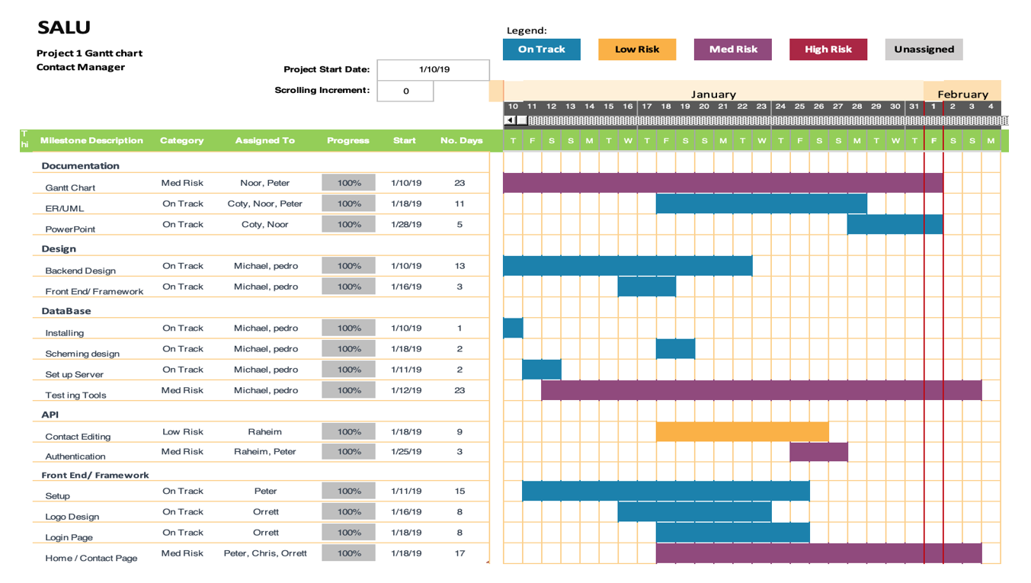

Slide 4
When I look at a Gantt chart…
I need to know what tasks are being worked on now and what tasks are upcoming.
When are the tasks due and what dependencies do they have.
Who is doing the tasks?
Is the project late, on time, or ahead.

Slide 5
Tools for Gantt Charts
GanttPro.com
TeamGantt
Excel
LucidChart.io
Can convert from Trello

Slide 6
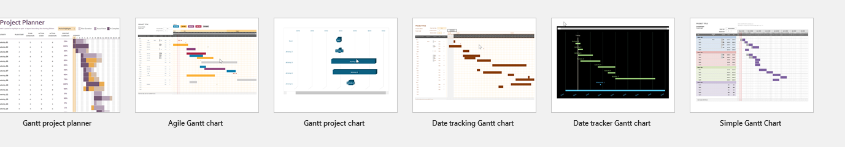
Gantt Charts from Excel
https://www.smartsheet.com/blog/gantt-chart-excel

Slide 7

What is it and what is it good for?
Project management tool.
Digital equivalent of laying out post it notes on your floor.
Allows you to prioritize your tasks and set deadlines.
Cloud-based so can be accessed wherever you have an internet connection.
Could be useful for e.g. group presentations, organizing your study time on a module, research projects.
Notes:
The phrase ‘project management’ is often heard in a corporate context. What could it mean in academia?: essays, assignments, getting to grips with the elements of a module you are enrolled on etc.
Digital equivalent of writing lists on paper, crossing things off, throwing them away when you’re done. Trello operates similarly, but online.

Slide 8

https://trello.com
Terms used by Trello
Boards: refers to the name of the project itself, or the task you want to achieve, e.g. the name of the presentation you are working on, or the name of a module that you are taking.
Lists: refers to the steps you need to work through, your workflow. A typical way to name lists is ‘to do’, ‘doing, ‘done’.
Cards: refers to the actual task you need to do to complete the project.
Notes:
Trello is free and easy to sign up for
Demonstration of creating a personal board in Trello, adding lists and cards
Demonstration of creating a team in Trello, and adding team members to a collaborative board.
YouTube tutorial available here: http://www.tubechop.com/watch/6865419

Slide 9
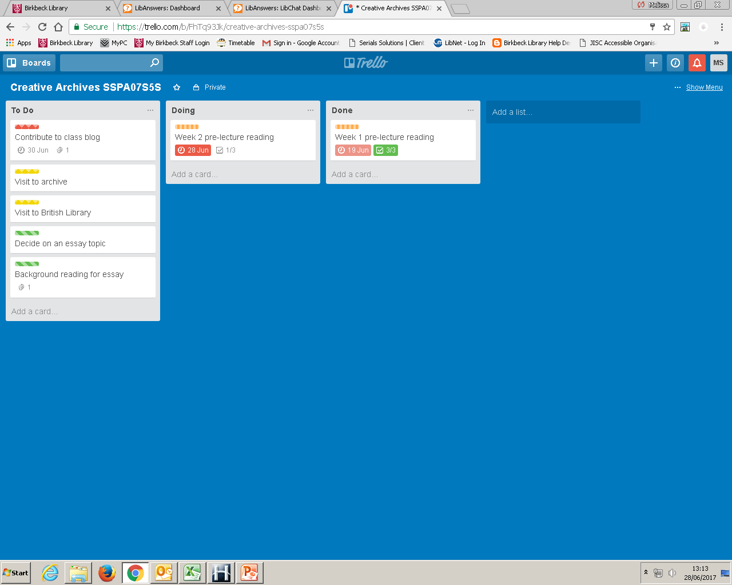
Trello ‘Board’. My project is to complete a module called “Creative Archives SSPA07S5S”.
My ‘Lists’ are labelled “To Do” “Doing” “Done” and I will move my cards across these lists as I complete them.
My ‘Cards’ have tasks that need completing e.g. “Background reading for essay”.

Slide 10
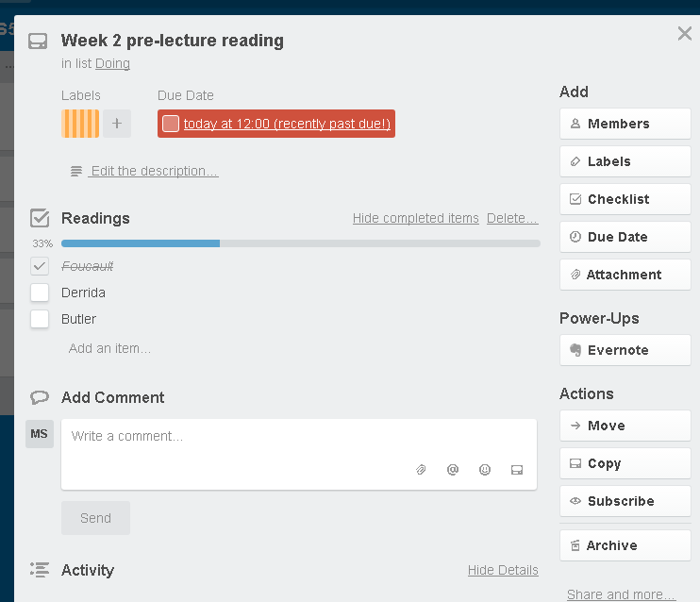
Example of a ‘Card’ labelled “Week 2 pre-lecture reading”.
I have set a due date for completing this card (Trello shows me this is overdue!).
I have colour coded it in orange so that I can use filters later to focus on this type of task.
I have added a checklist of readings I need to complete and ticked one as complete.

Slide 11
Recap of Trello’s features:
Name your ‘lists’ (workflow), and add ‘cards’ (tasks) that need to be completed. Move cards between lists as you complete them.
Attach due dates to cards. Trello will notify you by email when the date is looming.
Attach documents and links to cards for easy referral.
Create checklists within a card and Trello will show your progress as you work through it.
Color code your cards so you can focus on specific tasks.
Connect Trello with work you are doing in other apps such as Evernote – interoperable.
Notes:
If the Trello board is collaborative, each member assigned to a task will receive an email to remind them when a task is due to be completed
If you want to oversee the board, but not attach yourself to individual cards, ‘subscribe’ to the board and you will be notified whenever a member of your team completes a card, moves it to a new list or adds a comment

Slide 12
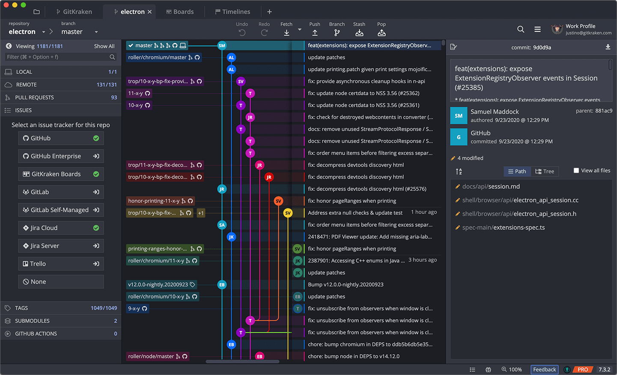
GitKraken

Slide 13
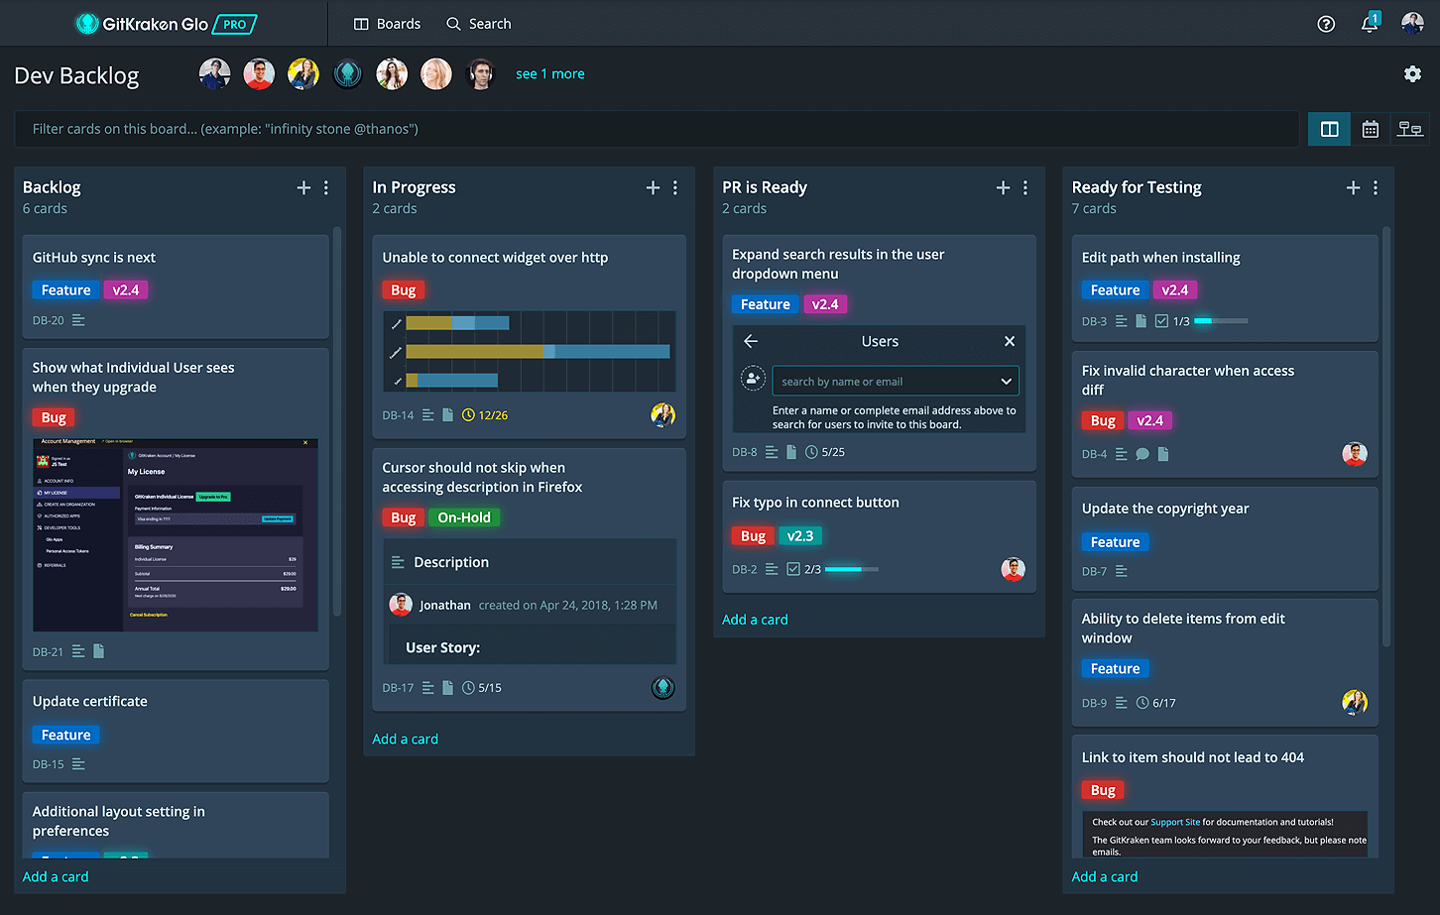
GitKraken Boards

Slide 14
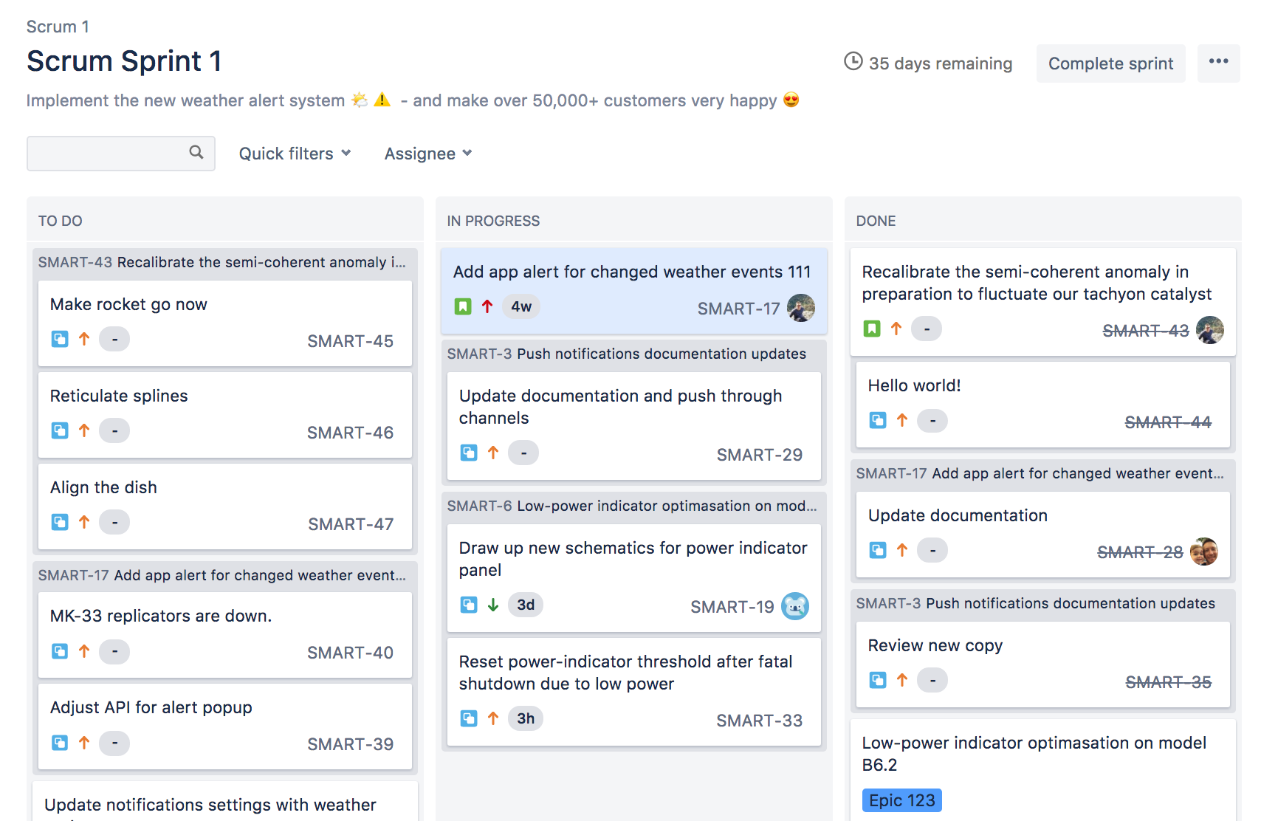
Jira – this is mainly intended for Agile teams

Slide 15
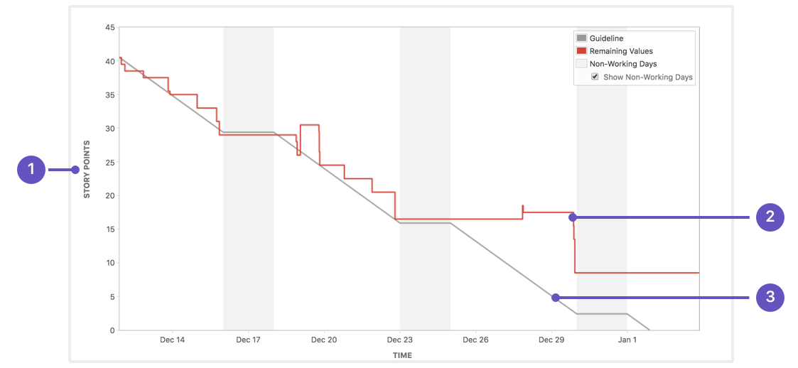
Burn Down Charts

Slide 16
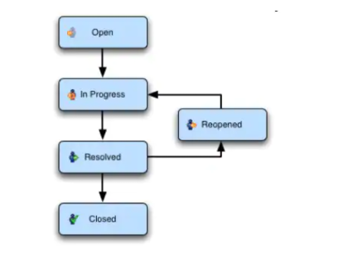
Jira

Slide 17
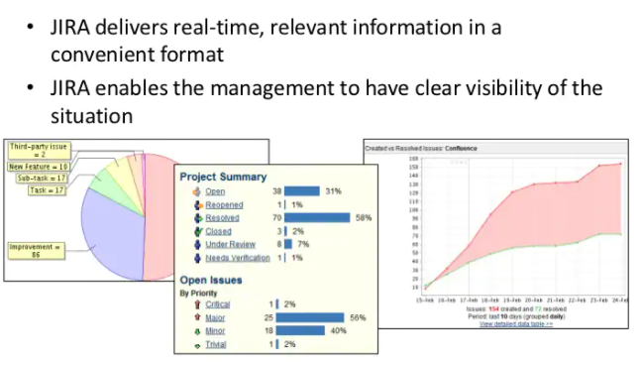
Jira Reports

Slide 18
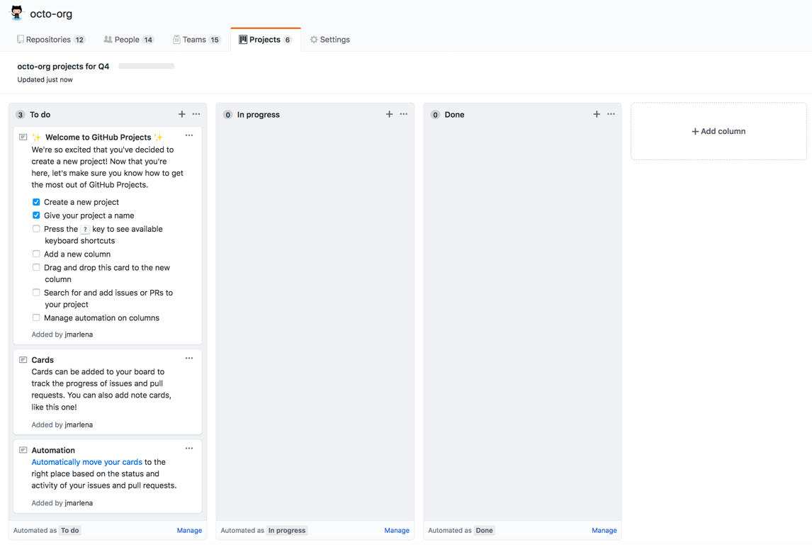
GitHub Issues

Slide 19
Modeling with Unified Modeling Language (UML)
COP 4331
University of Central Florida
Rick Leinecker

Slide 20
Why Model Your Applications?
Creating models helps to solidify design goals.
Provides design agreement amongst development teams.
Allows better communication with stakeholders with different points of view and communications.
A visual model can bridge the gap and provide a common understanding of a project.

Slide 21
Many UML Types
Use Case Diagrams
Class Diagram
Sequence Diagram
Activity Diagram
State Machine Object Diagram Profile
Timing Diagram Component Diagram Package
Communication Diagram Composite Structure Deployment

Slide 22
Non-UML Diagrams Important for this Course
Entity Relation Diagram
Gantt Chart
For Agile: Burn Down Charts

Slide 23
Use Case Diagrams
Use Case Diagrams provide a high-level snapshot of an application.
Complex applications require multiple Use Case Diagrams, which can be displayed as hierarchical diagrams.
These UML types are usually the best way to start when you are preparing to communicate with a wide variety of stakeholders.

Slide 24
Boundaries
Use Case Diagrams start with a boundary

Slide 25
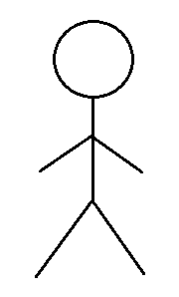
Actors
There are usually at least two actors, normally depicted as stick figures. Other things such as a database can be actors too.

Slide 26

Actors
There are usually at least two actors, normally depicted as stick figures. Other things such as a database can be actors too.

Slide 27
Use Cases
Use Cases are depicted as ellipses and have short text descriptions. The indicate functionality.
Insert Card
Enter PIN
Check Balance
Withdraw Money
Deposit Money

Slide 28
Includes
Use Cases that are related are usually connected with an include. Here inserting a card and entering a PIN are related.
Insert Card
<<include>>
Enter PIN
Check Balance
Withdraw Money
Deposit Money

Slide 29
Extends
Edge cases are noted with an extends.
<<extends>>
Insert Card
Exceeded Try Count
<<include>>
Enter PIN
Check Balance
Withdraw Money
Deposit Money

Slide 30
Lines
Lines normally connect actions.
<<extends>>
Insert Card
Exceeded Try Count
<<include>>
Enter PIN
Check Balance
Withdraw Money
Deposit Money

Slide 31
Lines
Lines normally connect actions.
<<extends>>
Insert Card
Exceeded Try Count
<<include>>
Enter PIN
Check Balance
Perform Transaction
Withdraw Money
Deposit Money

Slide 32
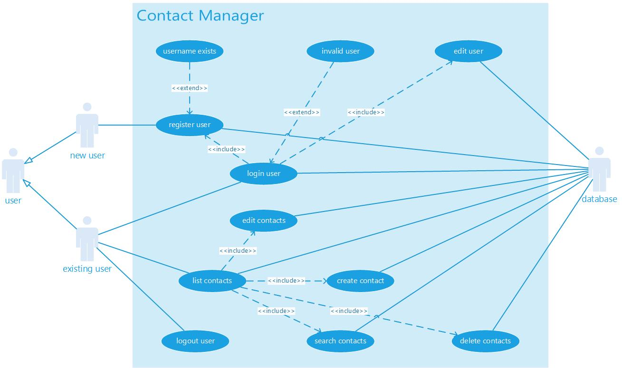
Example Use Case Diagrams

Slide 33
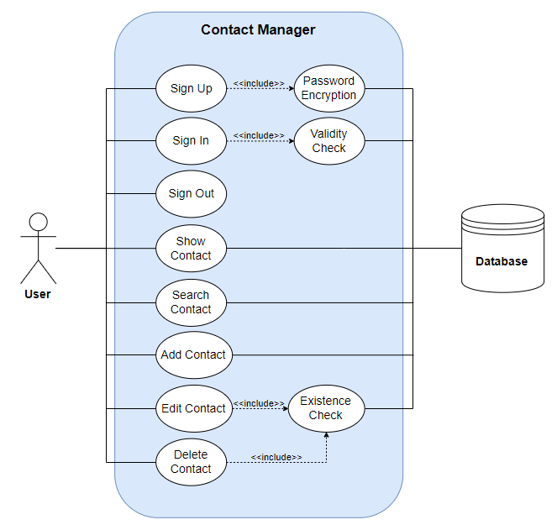

Slide 34
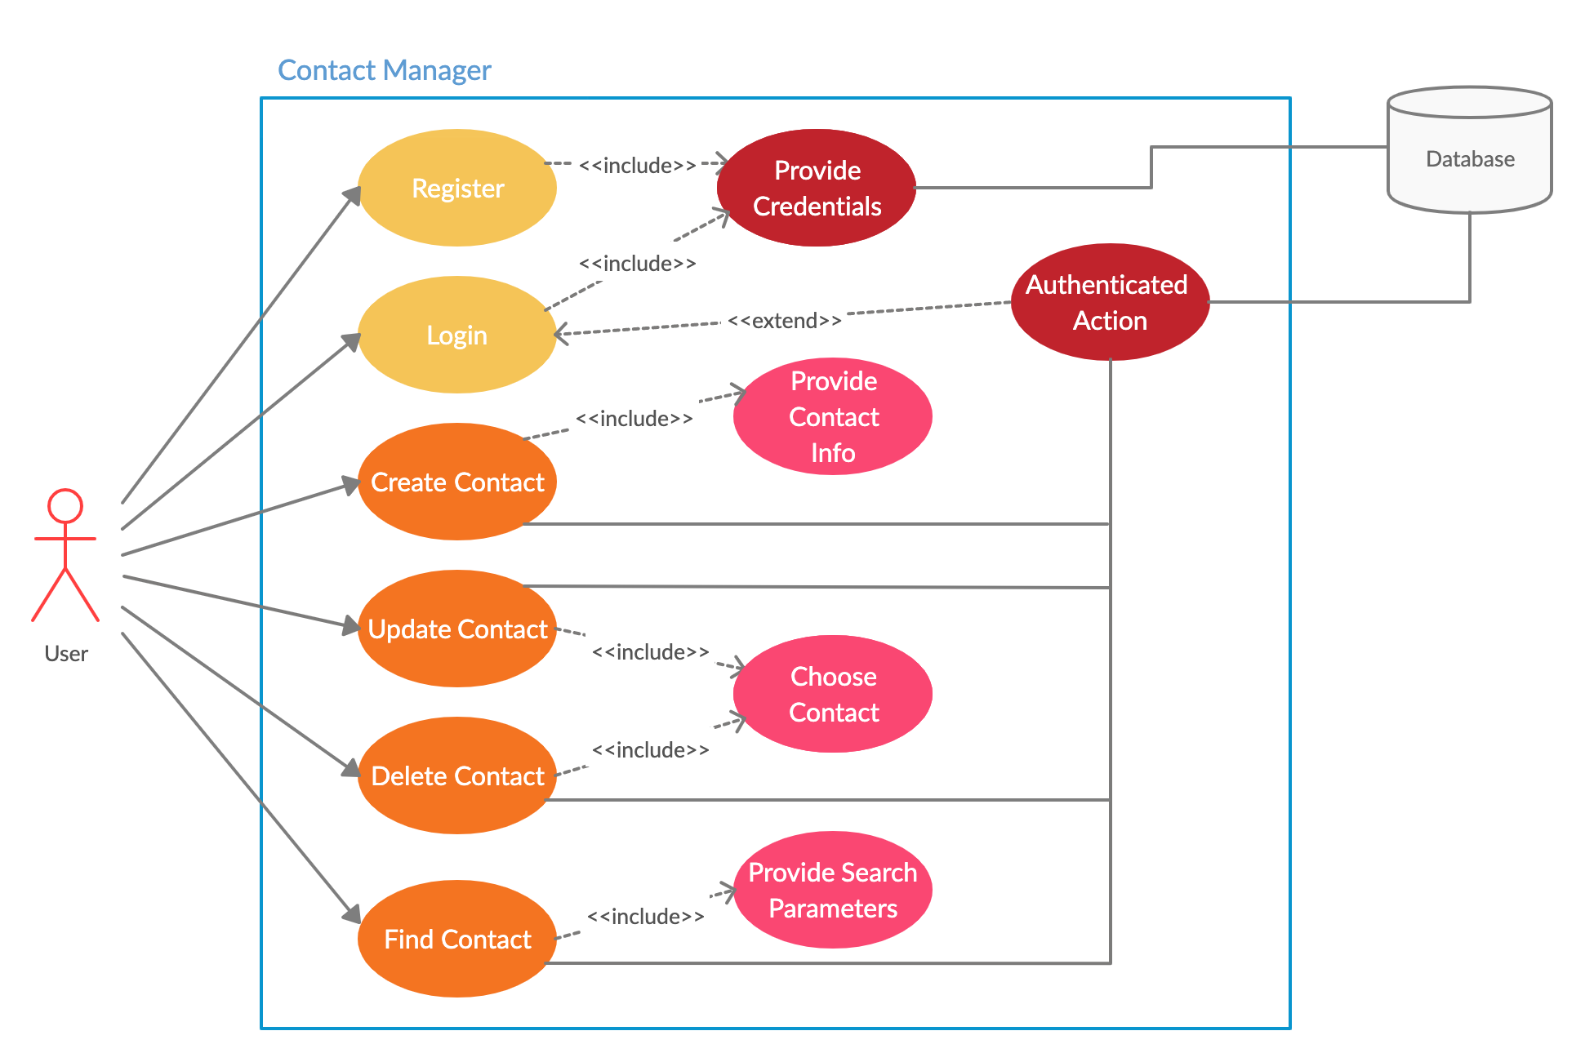

Slide 35
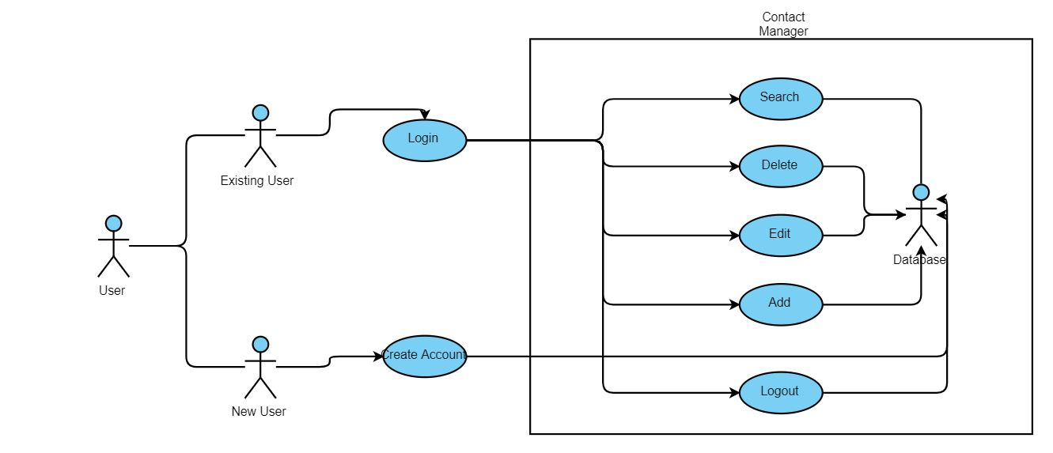

Slide 36
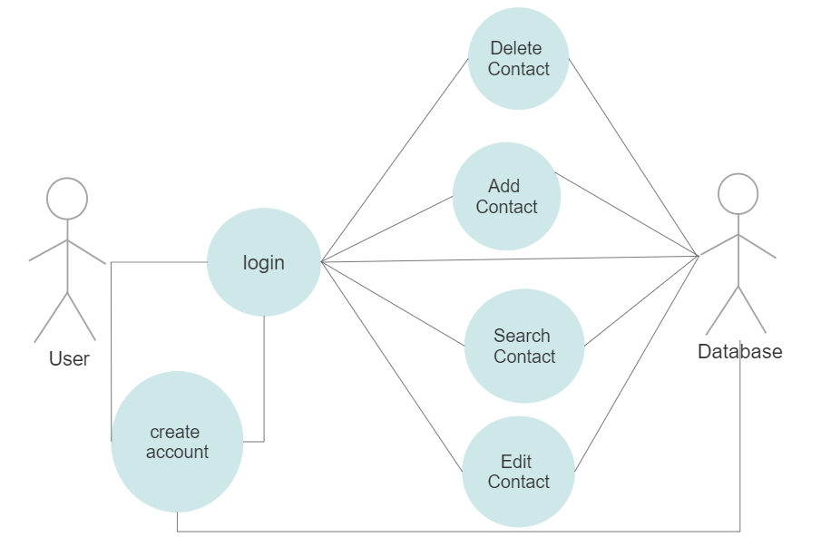

Slide 37
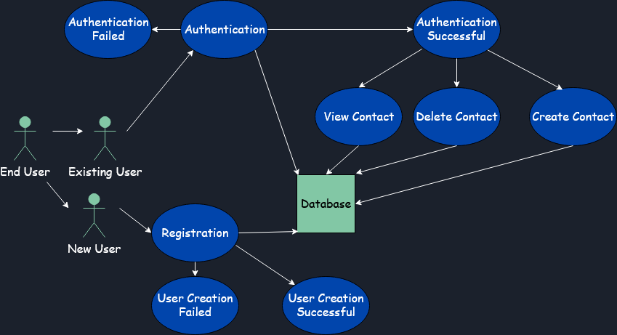

Slide 38
More General Thoughts on UML
if an application is to be of professional quality it must:
Meet the needs of the users
Be robust
Be maintainable
Be documented

Slide 39
Designing Software
Many developers using RAD tools will believe it makes sense to develop an application rapidly.
Write a prototype and then keep adding code until the application is complete.
There is however, a fundamental problem to this approach.
The resulting application will lack a well-defined, scalable architecture because it will not have been thought out properly.
This will more often than not compromise fundamental object oriented principals and result in undocumented, inefficient and difficult to maintain code.

Slide 40
Refine and Reduce Risk
With the use of UML, an appropriate UML development tool, and an application process or methodology, the design and refining of the application is shifted from the development phase to an analysis and design phase.
This reduces risk and provides a vehicle for testing the architecture of the system before coding begins.
The analysis and design overhead will eventually pay dividends as the system has been user driven, documented and when it’s time to start developing, many UML tools will generate skeleton code that will be efficient, object oriented and promote re-use.

Slide 41
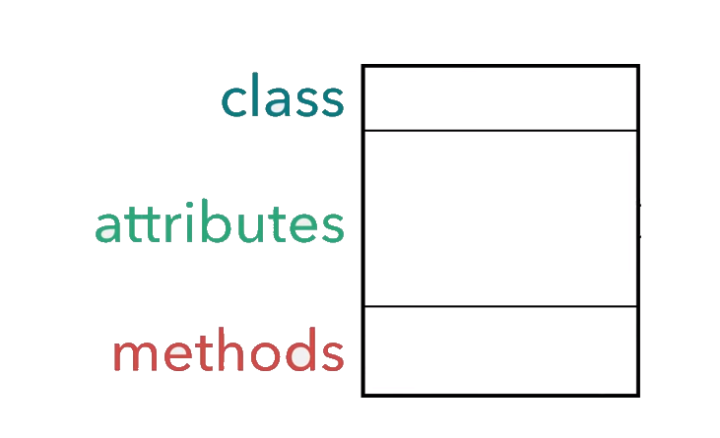
UML Class Diagrams

Slide 42
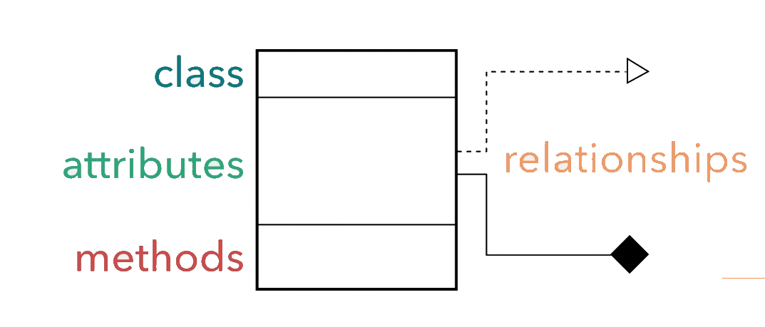
Also Relationships

Slide 43
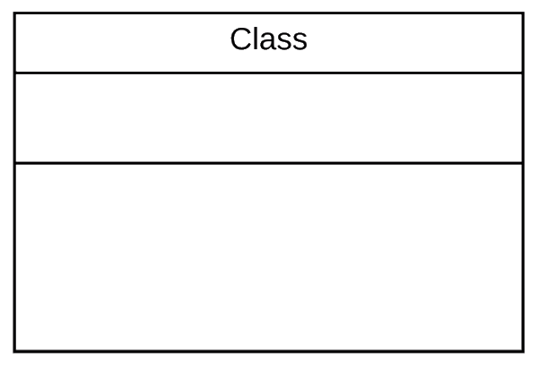
Zoo System

Slide 44
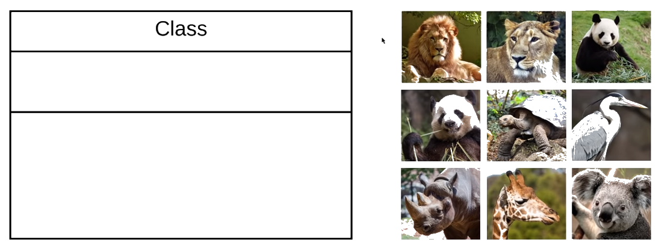
Zoo System

Slide 45
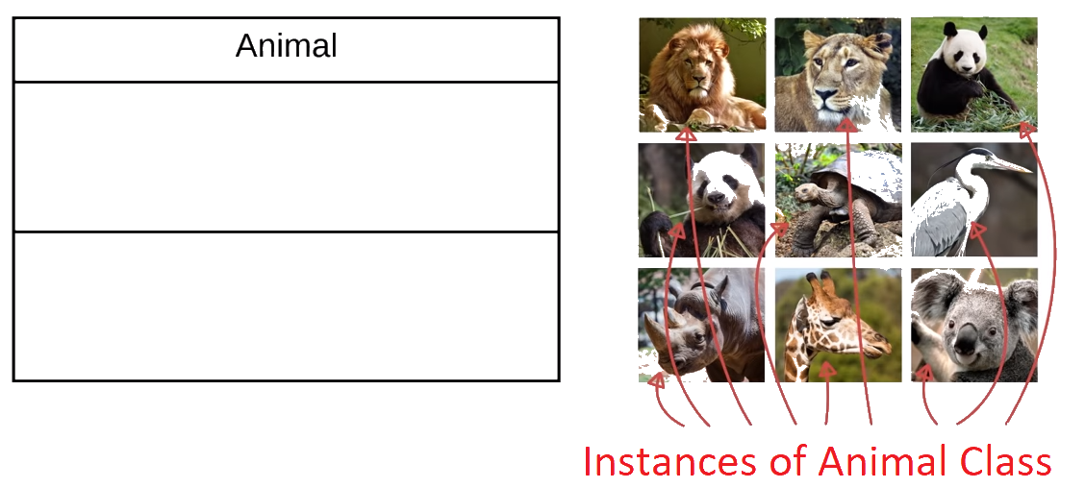
Zoo System

Slide 46
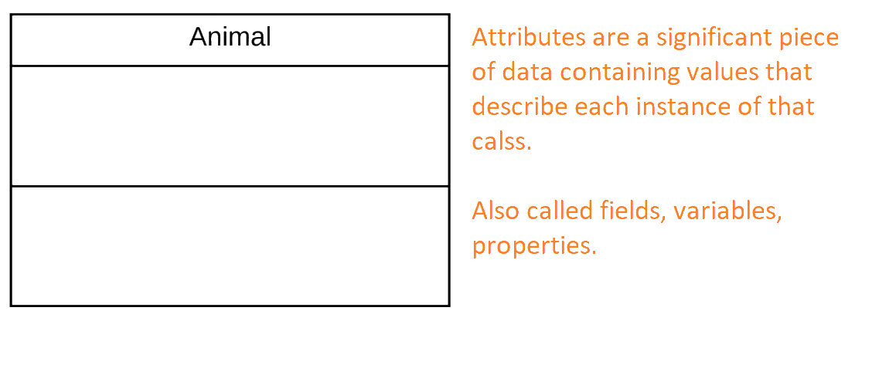

Zoo System

Slide 47
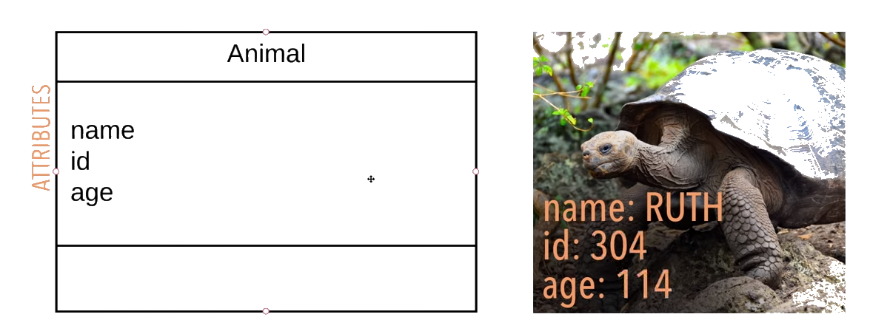
Zoo System

Slide 48
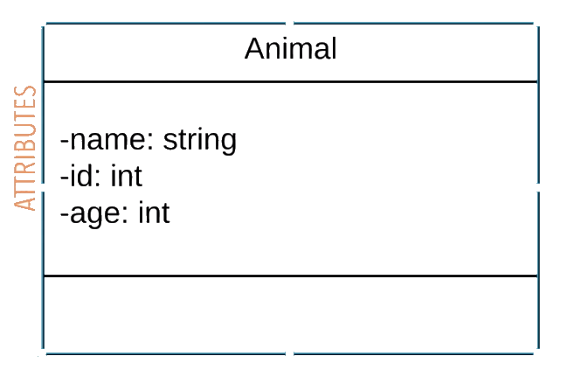
Zoo System

Slide 49
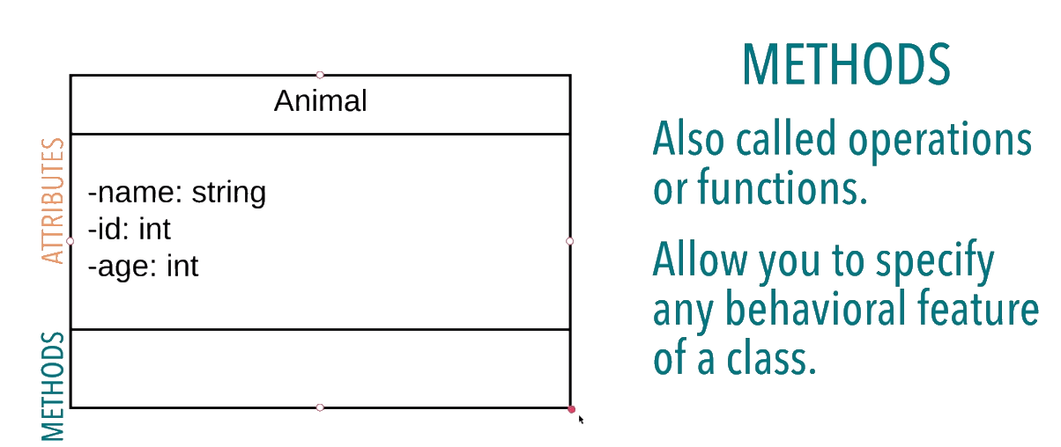
Zoo System

Slide 50
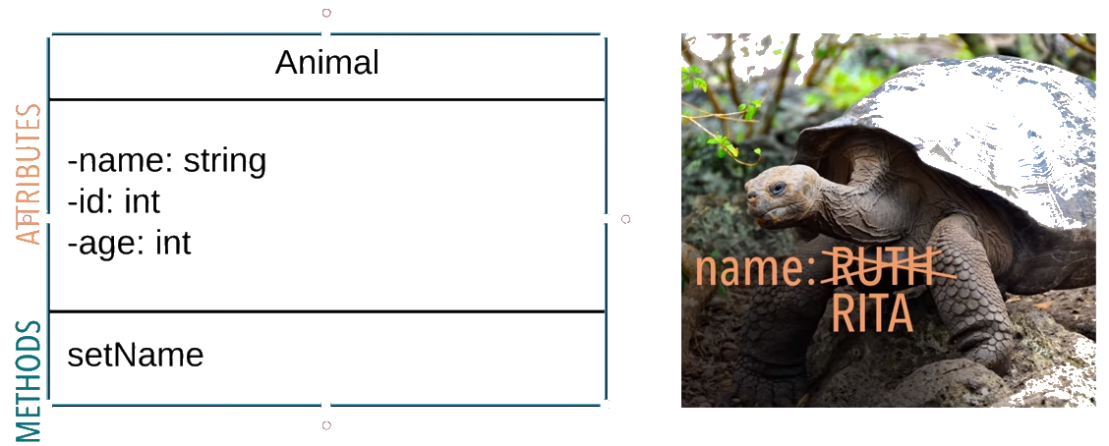
Zoo System

Slide 51
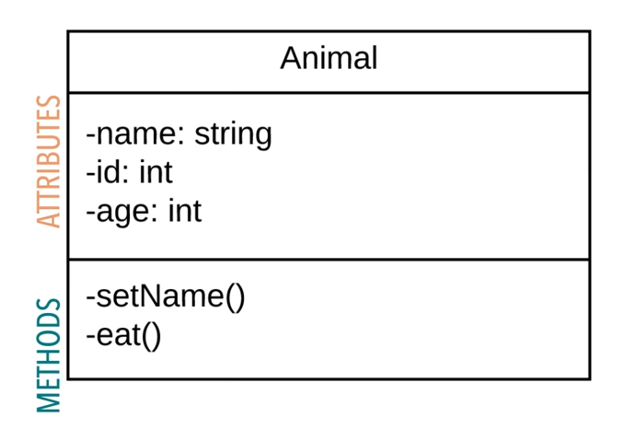
Zoo System

Slide 52
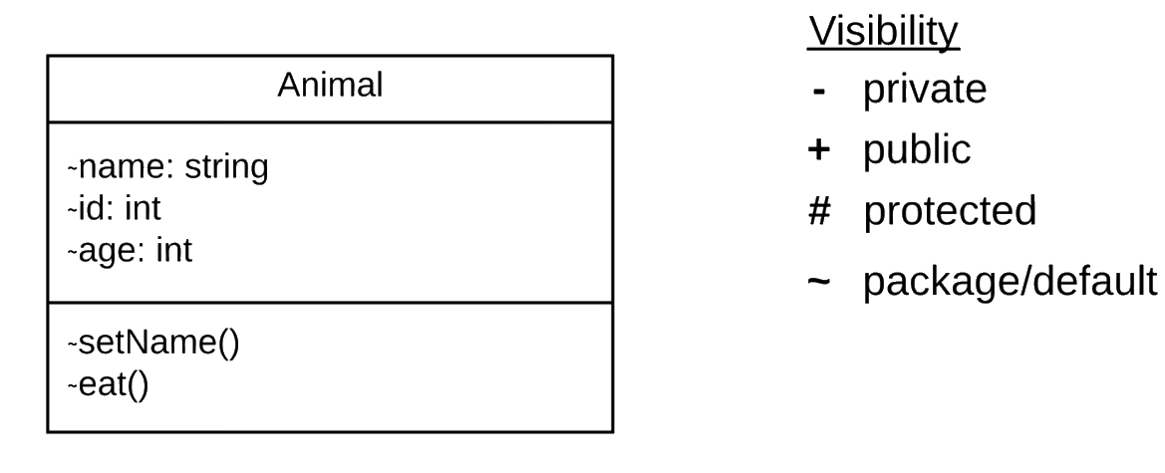
Zoo System

Slide 53
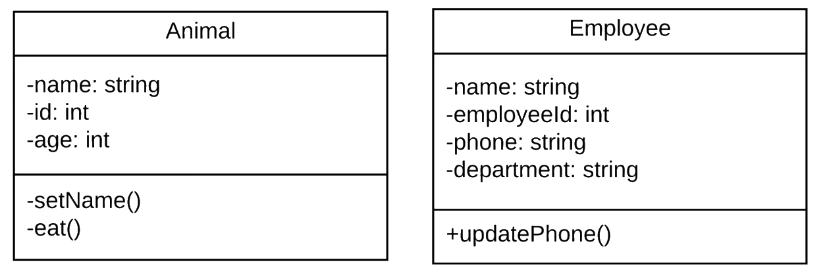
Zoo System

Slide 54
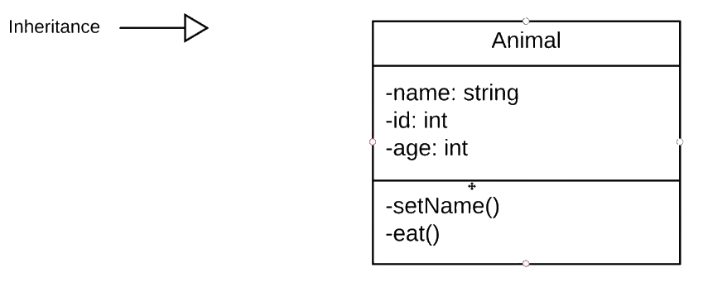
Relationships

Slide 55
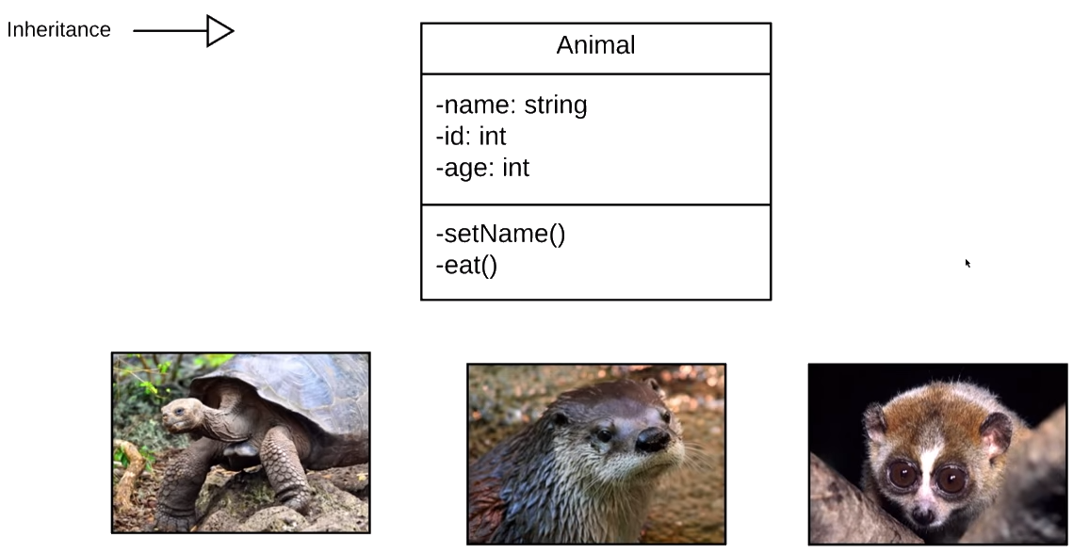
Relationships

Slide 56
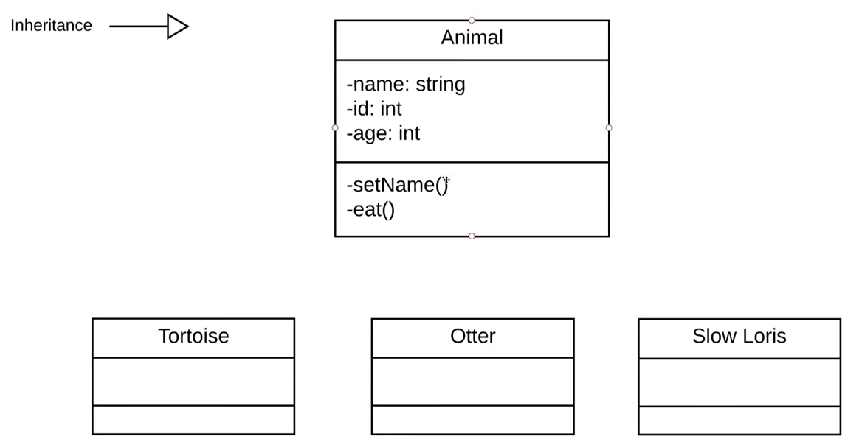
Relationships

Slide 57
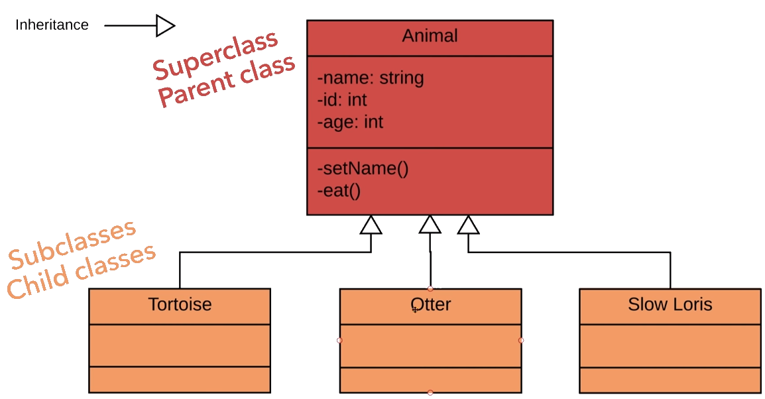
Relationships

Slide 58
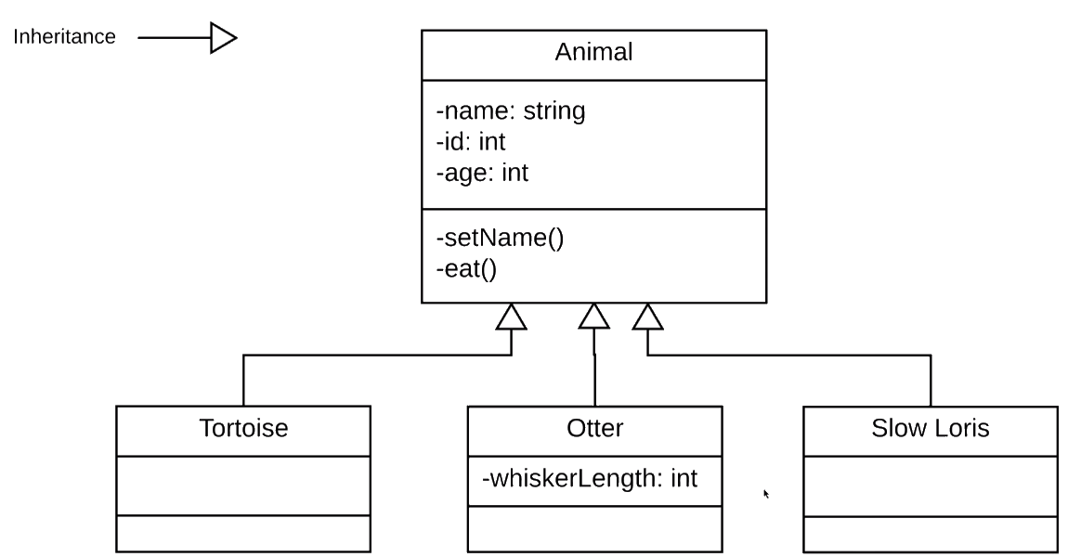
Relationships

Slide 59
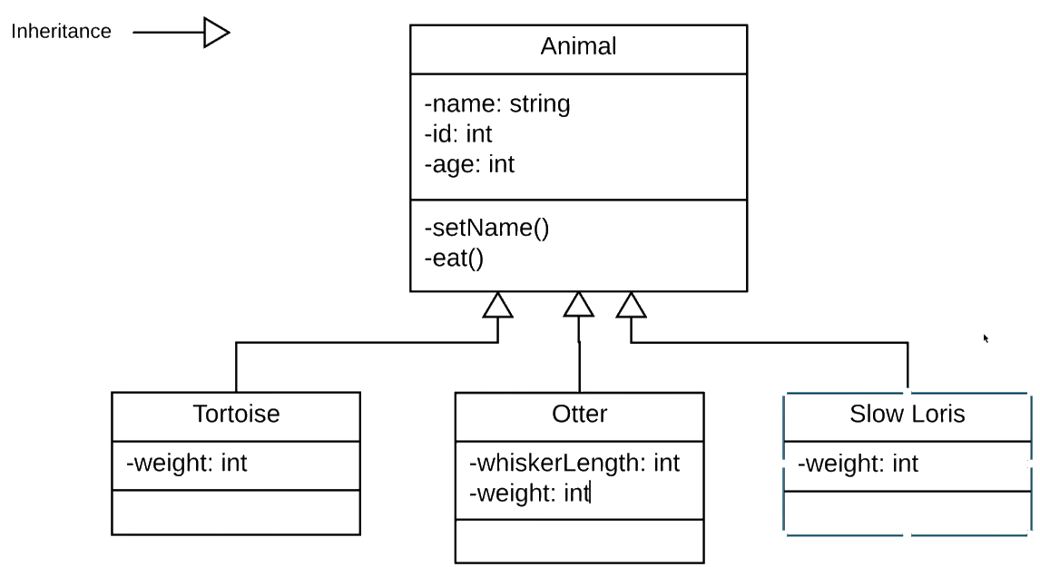
Relationships

Slide 60
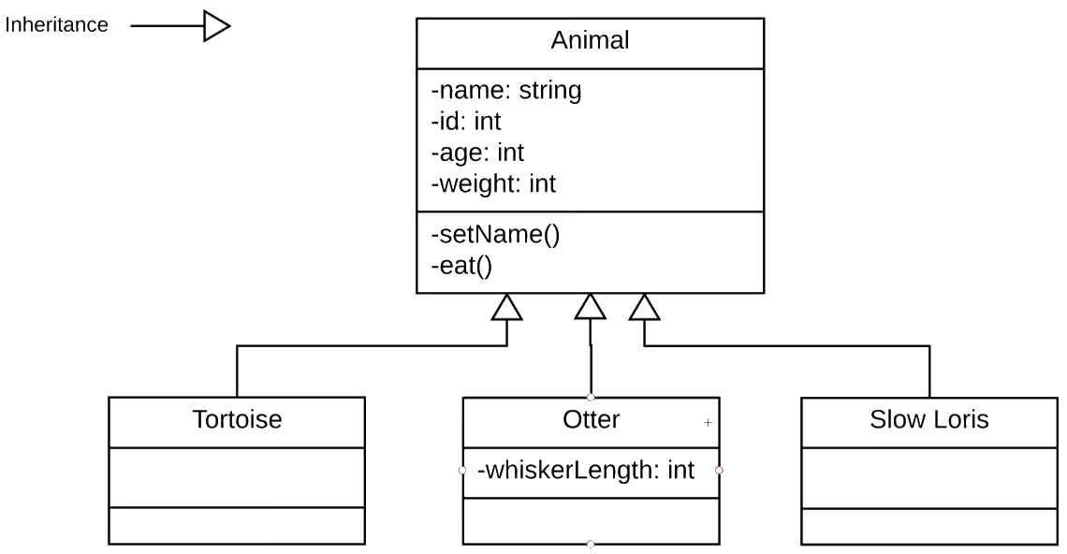
Relationships

Slide 61
Relationships
Abstraction

Slide 62
Relationships
Don’t
Repeat
Yourself

Slide 63
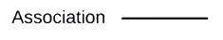
Relationships

Slide 64
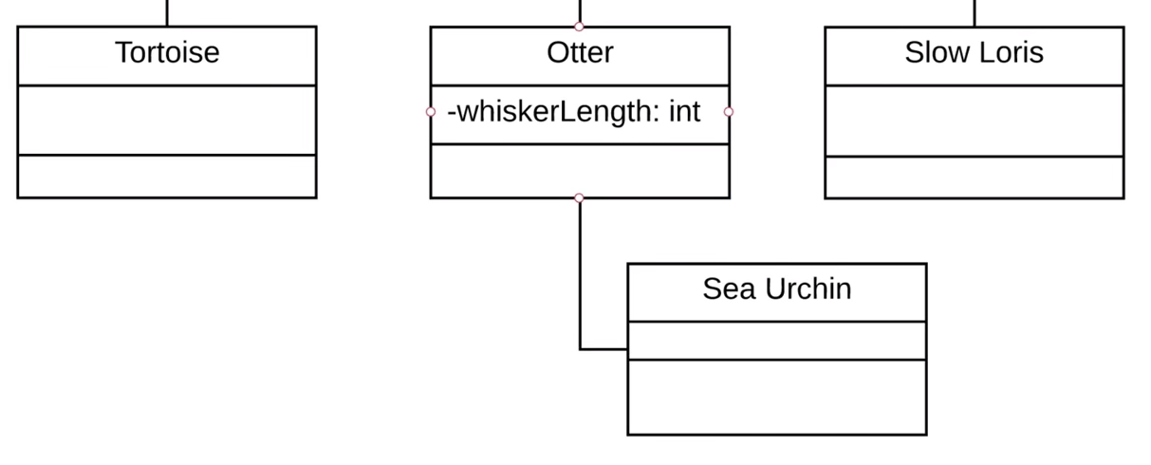
Relationships

Slide 65
Relationships
eats

Slide 66
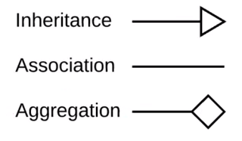
Relationships

Slide 67
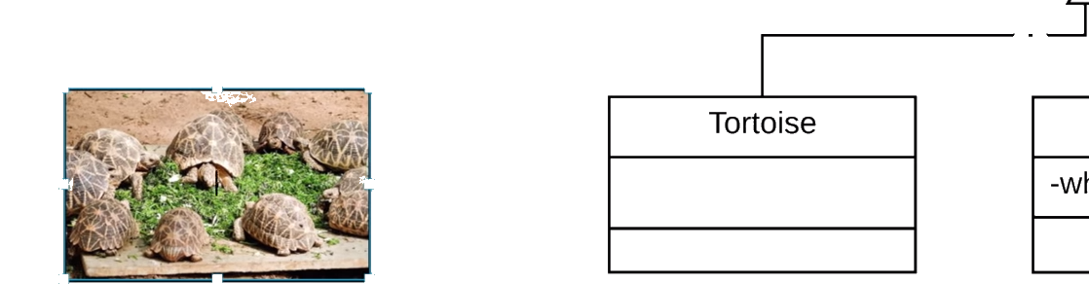
Relationships

Slide 68
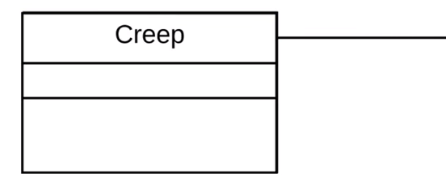
Relationships

Slide 69
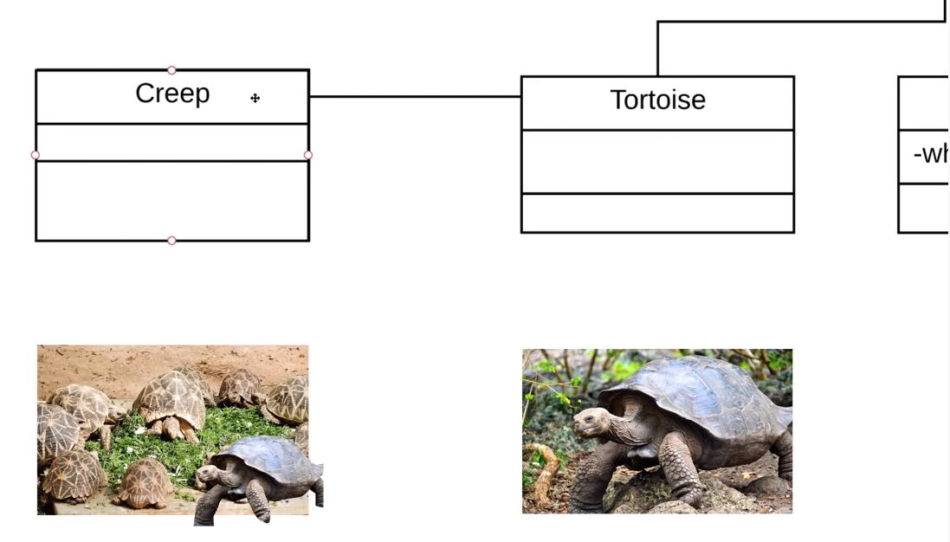
Relationships

Slide 70
Relationships
A tortoise can leave the
creep at any time and
still be a tortoise.

Slide 71
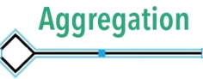
Relationships

Slide 72
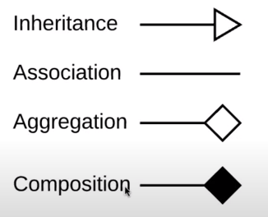
Relationships

Slide 73
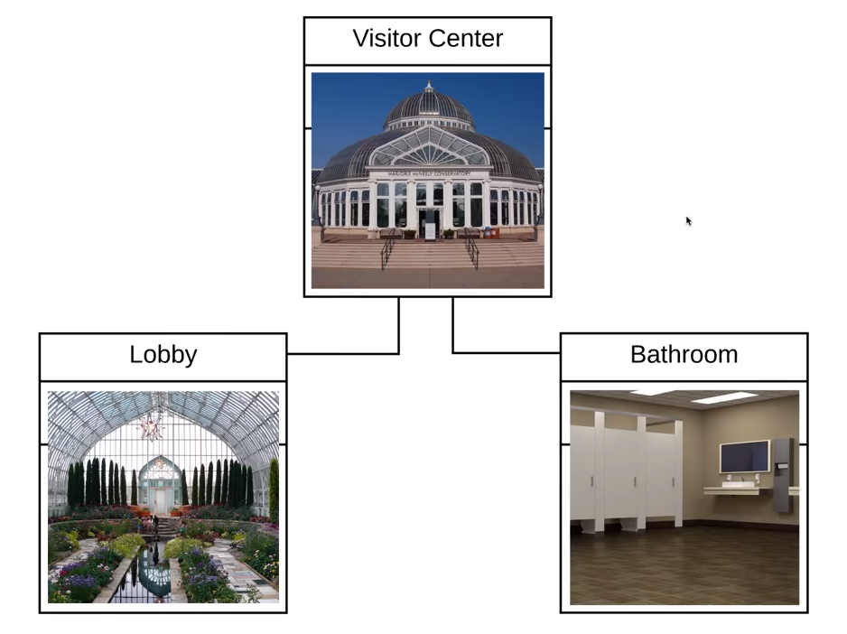
Relationships

Slide 74
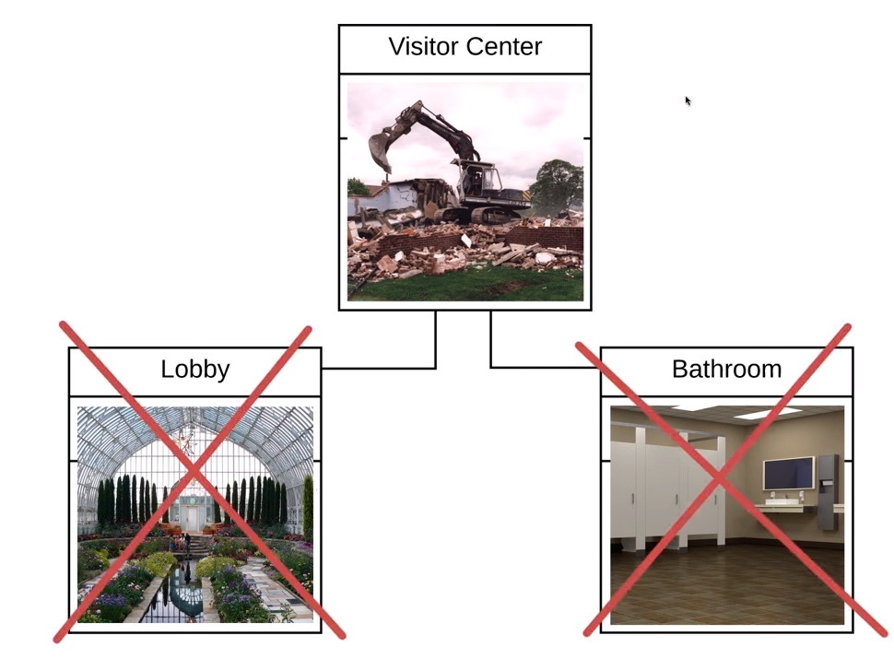
Relationships

Slide 75
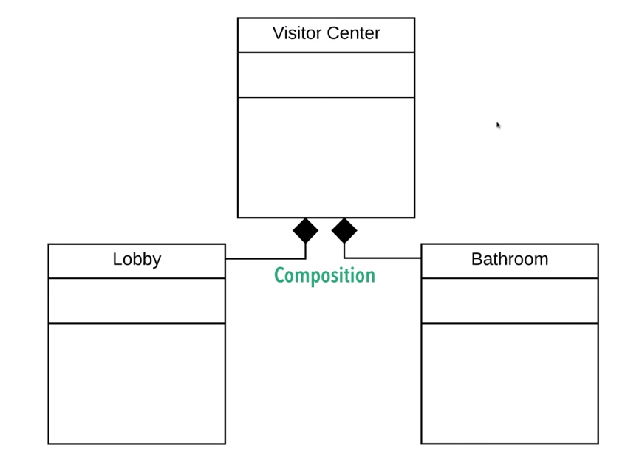
Relationships

Slide 76
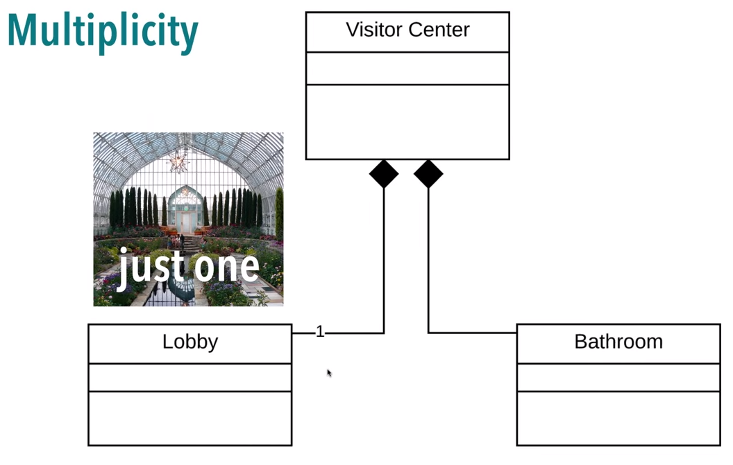
Relationships

Slide 77

Relationships

Slide 78

Relationships

Slide 79

Examples

Slide 80


Slide 81


Slide 82


Slide 83
Sequence Diagrams
A series of diagrams describing the dynamic behavior of an object-oriented system.
A set of messages exchanged among a set of objects within a context to accomplish a purpose.
Often used to model the way a use case is realized through a sequence of messages between objects.

Slide 84
Sequence Diagrams (Cont.)
The purpose of Interaction diagrams is to:
Model interactions between objects
Assist in understanding how a system (a use case) actually works
Verify that a use case description can be supported by the existing classes
Identify responsibilities/operations and assign them to classes

Slide 85
A First Look at Sequence Diagrams
Illustrates how objects interacts with each other.
Emphasizes time ordering of messages.
Can model simple sequential flow, branching, iteration, recursion and concurrency.

Slide 86

ATM Example

Slide 87

User (Actor) Goes to Get Money
ATM Example

Slide 88

ATM Example
Bank Server is Contact

Slide 89

ATM Example
Bank Account is Contacted by Server

Slide 90

ATM Example
The ATM, Server, and Account are Objects in the Diagram

Slide 91

ATM Example
The Customer is not an Object, but an Actor

Slide 92

ATM Example
Actor – actors are always outside of the diagram

Slide 93

Actors are normally stick figures, objects rectangles
ATM Example

Slide 94

ATM Example
Start by placing actor to the left

Slide 95

ATM Example
Add the objects

Slide 96

ATM Example
ATM, Bank Server, and Bank Account

Slide 97

ATM Example
Next are the lifelines

Slide 98

ATM Example
Lifelines go from each object moving to the bottom

Slide 99

Actors and objects each have a lifeline
Think of all the steps for the actor to make a withdrawal
ATM Example

Slide 100

ATM Example
The first message is inserting the card

Slide 101

ATM Example
Messages show the interaction between lifelines

Slide 102

ATM Example
We sometimes move down the lifelines

Slide 103

ATM Example
Insert card messsage

Slide 104

ATM Example
Verify card

Slide 105

ATM Example
Objects can return messages

Slide 106

ATM Example
Dotted line for returned message to requester

Slide 107

Requesting PIN is not a return message and not dotted
ATM Example

Slide 108

What if the card is bad? Then we have an alternative frame
ATM Example

Slide 109

Alternative frames offer two choices that are usually mutually exclusive
ATM Example

Slide 110

ATM Example
Place an alternative box

Slide 111

ATM Example
Card is valid

Slide 112

ATM Example
Card is not valid

Slide 113

ATM Example
Completed alternate frame

Slide 114

ATM Example
PIN entered response (dotted line)

Slide 115

ATM Example
Verify PIN

Slide 116

ATM Example
Need alternate frame for PIN valid/invalid

Slide 117

Move through objects to account – are there sufficient funds?
ATM Example

Slide 118

ATM Example
Dispense cash

Slide 119

Alternate frame for funds sufficient/insufficient
ATM Example

Slide 120

ATM Example
Finally, card ejected

Slide 121

Add activation boxes – show how long an object is in use
ATM Example

Slide 122

Activation boxes in place – actors are external and do not have activation boxes

Slide 123
Activity Diagram
Describes how activities are coordinated.
Is particularly useful when you know that an operation has to achieve a number of different things, and you want to model what the essential dependencies between them are, before you decide in what order to do them.
Records the dependencies between activities, such as which things can happen in parallel and what must be finished before something else can start.
Represents the workflow of the process.

Slide 124
Notation
2. Transition
Activity1()
Activity2()
1. Activities

Slide 125
Notation - 2
[x>0]
[x>0]
Activity1()
[x=0]
[x=0]
[x<0]
[x<0]
3. Decision Diamond

Slide 126
Notation - 3
4.1 Synch. Bar (Join)
4.2 Splitting Bar (Fork)
{AND}
{OR}
{XOR}

Slide 127
Notation - 3
Start Marker
Stop Marker
5. Start & Stop Markers

Slide 128
Notation - 4
Developers
Testers
Markers
Swimlane
Swimlane
Swimlane
Application/Department/Group/Role Boundaries

Slide 129
Example: Business Level Activity Diagram
of the Library
member
Librarian
[borrower]
Find book on shelf
[returning]
[returner]
Wait in queue
[borrowing]
Record return
Put book back of shelf
Record borrowing
Prepare for next
member

Slide 130
Activity Diagrams (1)
To model the dynamic aspects of a system
It is essentially a flowchart
Showing flow of control from activity to activity
Purpose
Model business workflows
Model operations

Slide 131
Activity Diagrams (2)
Activity diagrams commonly contain
Activity states and action states
Transitions
Objects

Slide 132
Action States and Activity States
Action states are atomic and cannot be decomposed
Work of the action state is not interrupted
Activity states can be further decomposed
Their activity being represented by other activity diagrams
They may be interrupted

Slide 133
Transitions (1)
When the action or activity of a state completes, flow of control passes immediately to the next action or activity state
A flow of control has to start and end someplace
initial state -- a solid ball
stop state -- a solid ball inside a circle

Slide 134

Transitions (2)

Slide 135

Activity Diagram: Example (1)

Slide 136
Branching (1)
A branch specifies alternate paths taken based on some Boolean expression
A branch may have one incoming transition and two or more outgoing ones

Slide 137

Branching (2)

Slide 138

Activity Diagram: Example (2)

Slide 139
Forking and Joining
Use a synchronization bar to specify the forking and joining of parallel flows of control
A synchronization bar is rendered as a thick horizontal or vertical line

Slide 140
Fork
A fork may have one incoming transitions and two or more outgoing transitions
each transition represents an independent flow of control
conceptually, the activities of each of outgoing transitions are concurrent
either truly concurrent (multiple nodes)
or sequential yet interleaved (one node)

Slide 141
Join
A join may have two or more incoming transitions and one outgoing transition
above the join, the activities associated with each of these paths continues in parallel
at the join, the concurrent flows synchronize
each waits until all incoming flows have reached the join, at which point one flow of control continues on below the join

Slide 142

Fork

Slide 143

Activity Diagram: Example (3)

Slide 144

Activity Diagram: Example (4)

Slide 145

Activity Diagram: Example (5)

Slide 146

Activity Diagram: Example (6)

Slide 147

Activity Diagram: Example (7)

Slide 148
Swimlanes (1)
A swimlane specifies a locus of activities
To partition the activity states on an activity diagram into groups
each group representing the business organization responsible for those activities
each group is called a swimlane
Each swimlane is divided from its neighbor by a vertical solid line

Slide 149
Swimlanes (2)
Each swimlane has a name unique within its diagram
Each swimlane may represent some real-world entity
Each swimlane may be implemented by one or more classes
Every activity belongs to exactly one swimlane, but transitions may cross lanes

Slide 150

Activity Diagram: Example (8)

Slide 151

Activity Diagram: Example (9)

